Slide 1
Syllabus
Introduction Key Concepts Types of Threats
Best Practices Emerging Trends Conclusion
Cybersecurity

Slide 2



Syllabus Introduction Key Concepts Types of Threats
Best Practices Emerging Trends Conclusion
Table of Contents
Syllabus
Unit-I: 10 Lecture Hours UNIT II: 12 Lecture Hours UNIT III: 11 Lecture Hours UNIT IV: 12 Lecture Hours
2 Introduction Key Concepts
Types of Threats Best Practices Emerging Trends Conclusion
1
3
4
5
6
7

Slide 3
Syllabus Introduction Key Concepts Types of Threats
Best Practices Emerging Trends Conclusion
Course Objectives
To enable the students to understand the basic concepts of cyber security in the connected world.

Slide 4
Syllabus Introduction Key Concepts Types of Threats
Best Practices Emerging Trends Conclusion
Course Outcomes
CO1: Describe the fundamentals of Cyber Security.
CO2: Analyze several types of vulnerabilities, attacks, and cryptography concepts.
CO3: Apply the various approaches for information security audit.
CO4: Categorize the Physical and Network vulnerabilities and Security threats.

Slide 5
Syllabus Introduction Key Concepts Types of Threats
Best Practices Emerging Trends Conclusion
Textbooks and Reference Books
Textbooks
N. S. Godbole, Information Systems Security, Wiley, 2009.
V. K. Jain, Cryptography and Network Security, Khanna Publishing House, 2013.
Reference Books
P. V. K, Cryptography and Information Security, Third Edition, PHI Learning Pvt. Ltd., 2019.

Slide 6
Syllabus Introduction Key Concepts Types of Threats
Best Practices Emerging Trends Conclusion
Assessment Weightage
Components | IA | MID SEM | End Sem | Total
Weightage (%) | 50 | 20 | 30 | 100
Table: Assessment Weightage Distribution

Slide 7
Syllabus Introduction Key Concepts Types of Threats
Best Practices Emerging Trends Conclusion
Internal Assessment Weightage
Internal Assessment Component | Weightage (100 marks)
Quiz 1 | 15%
Quiz 2 | 15%
Class Test 1 | 15%
Class Test 2 | 15%
Assignment 1/Project | 20%
Assignment 2/Project | 20%
Table: Weightage of Internal Assessment Components

Slide 8
Syllabus Introduction Key Concepts Types of Threats
Best Practices Emerging Trends Conclusion
Unit -1
Introduction to Cyber Space Introduction to Information Systems Need for Cyber Security Introduction to Cyber Attacks Classification of Cyber Attacks

Slide 9
Syllabus Introduction Key Concepts Types of Threats
Best Practices Emerging Trends Conclusion
Unit-II: Malware and Security Tools
Classification of Malware Threats
Explanation of Malware
Types of Malware: Virus Worms Trojans Rootkits Robots Adware Spyware Ransomware Zombies
Malware Analysis
Open Source Tools:
Antivirus Protection Anti-Spyware
System Tuning Tools
Anti-Phishing Vulnerability Assessment
Intrusion Detection Systems (IDS)
Intrusion Prevention Systems (IPS)

Slide 10
Syllabus Introduction Key Concepts Types of Threats
Best Practices Emerging Trends Conclusion
UNIT III:Cryptography and Cryptanalysis
Introduction to Cryptography Symmetric Key Cryptography Asymmetric Key Cryptography Message Authentication Digital Signatures Applications of Cryptography

Slide 11
Syllabus Introduction Key Concepts Types of Threats
Best Practices Emerging Trends Conclusion
UNIT IV: Cyber Law-Basics
Information Technology Act 2000 Amendments to IT Act 2000 Evidentiary Value of Email/SMS
Cybercrimes and Offenses Dealt with IPC RBI Act and IPR Act in India Jurisdiction of Cyber Crime
Cyber Security Awareness Tips

Slide 12
Syllabus
Introduction Key Concepts Types of Threats
Best Practices Emerging Trends Conclusion
Welcome to the Basics!
Discover the fundamental concepts and key principles.

Slide 13
Syllabus Introduction Key Concepts Types of Threats
Best Practices Emerging Trends Conclusion
Introduction
Definition of Cybersecurity Importance of Cybersecurity Key Concepts

Slide 14
Syllabus Introduction Key Concepts Types of Threats
Best Practices Emerging Trends Conclusion
Introduction to Cybersecurity
Definition of Cybersecurity
Cybersecurity refers to the practice of protecting systems, networks, and data from digital attacks, unauthorized access, and damage. It involves implementing various technologies, processes, and practices to safeguard information and ensure the integrity, confidentiality, and availability of digital assets.
Importance of Cybersecurity
Protection of Sensitive Data: Safeguards personal, financial, and sensitive information from breaches and theft.
Prevention of Cyber Attacks: Shields against various types of cyber
threats such as malware, ransomware, and phishing.
Maintaining Trust and Reputation: Ensures that organizations and individuals maintain trust and a positive reputation by protecting against data breaches and security incidents.
Compliance with Regulations: Helps organizations adhere to regulatory
requirements and standards related to data protection and privacy. Ensuring Business Continuity: Minimizes disruptions and potential financial losses by preventing and mitigating the impact of cyber incidents.

Slide 15
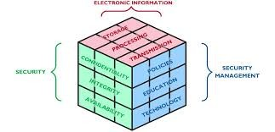
Syllabus Introduction Key Concepts Types of Threats
Best Practices Emerging Trends Conclusion
Key Concepts
Confidentiality Integrity Availability Authentication
Non- repudiation

Slide 16
Syllabus Introduction Key Concepts Types of Threats
Best Practices Emerging Trends Conclusion
Types of Threats
Malware Phishing
Denial of Service (DoS) Attacks Man-in-the-Middle (MitM) Attacks Insider Threats

Slide 17
Syllabus Introduction Key Concepts Types of Threats
Best Practices Emerging Trends Conclusion
Malware
Malware, short for malicious software, is any software intentionally designed to cause damage to a computer, server, client, or network. Types of malware include:
Viruses: Attach themselves to legitimate software and spread when the software is executed.
Worms: Self-replicate and spread independently across networks.
Trojan Horses: Disguise themselves as legitimate software but perform malicious activities once installed.
Ransomware: Encrypts a user’s files and demands a ransom for decryption.
Spyware: Collects user data without their consent.

Slide 18
Syllabus Introduction Key Concepts Types of Threats
Best Practices Emerging Trends Conclusion
Types of Malware
Type of Malware | Description | Method of Spread | Impact | Examples
Virus | Attaches itself to legitimate soft- ware. | Spread when the infected software is executed. | Corrupts or dam- ages files and sys- tems. | ILOVEYOU, Melissa Virus
Worm | Self-replicates and spreads indepen- dently. | Over networks or through vulnera- bilities. | Can overwhelm network resources and systems. | WannaCry, Conficker
Trojan Horse | Disguises as legiti- mate software but performs malicious activities. | Spread through deceptive down- loads or software. | Allows unautho- rized access or damage. | Emotet, Zeus Trojan
Ransomware | Encrypts files and demands a ransom for decryption. | Spread via email attachments, mali- cious links, or ex- ploits. | Locks access to files until ransom is paid. | Cryptolocker, Ryuk
Spyware | Collects user data without consent. | Often installed via bundled software or malicious down- loads. | Steals personal in- formation or moni- tors activities. | Keyloggers, Adware
Table: Comparison of Different Types of Malware

Slide 19
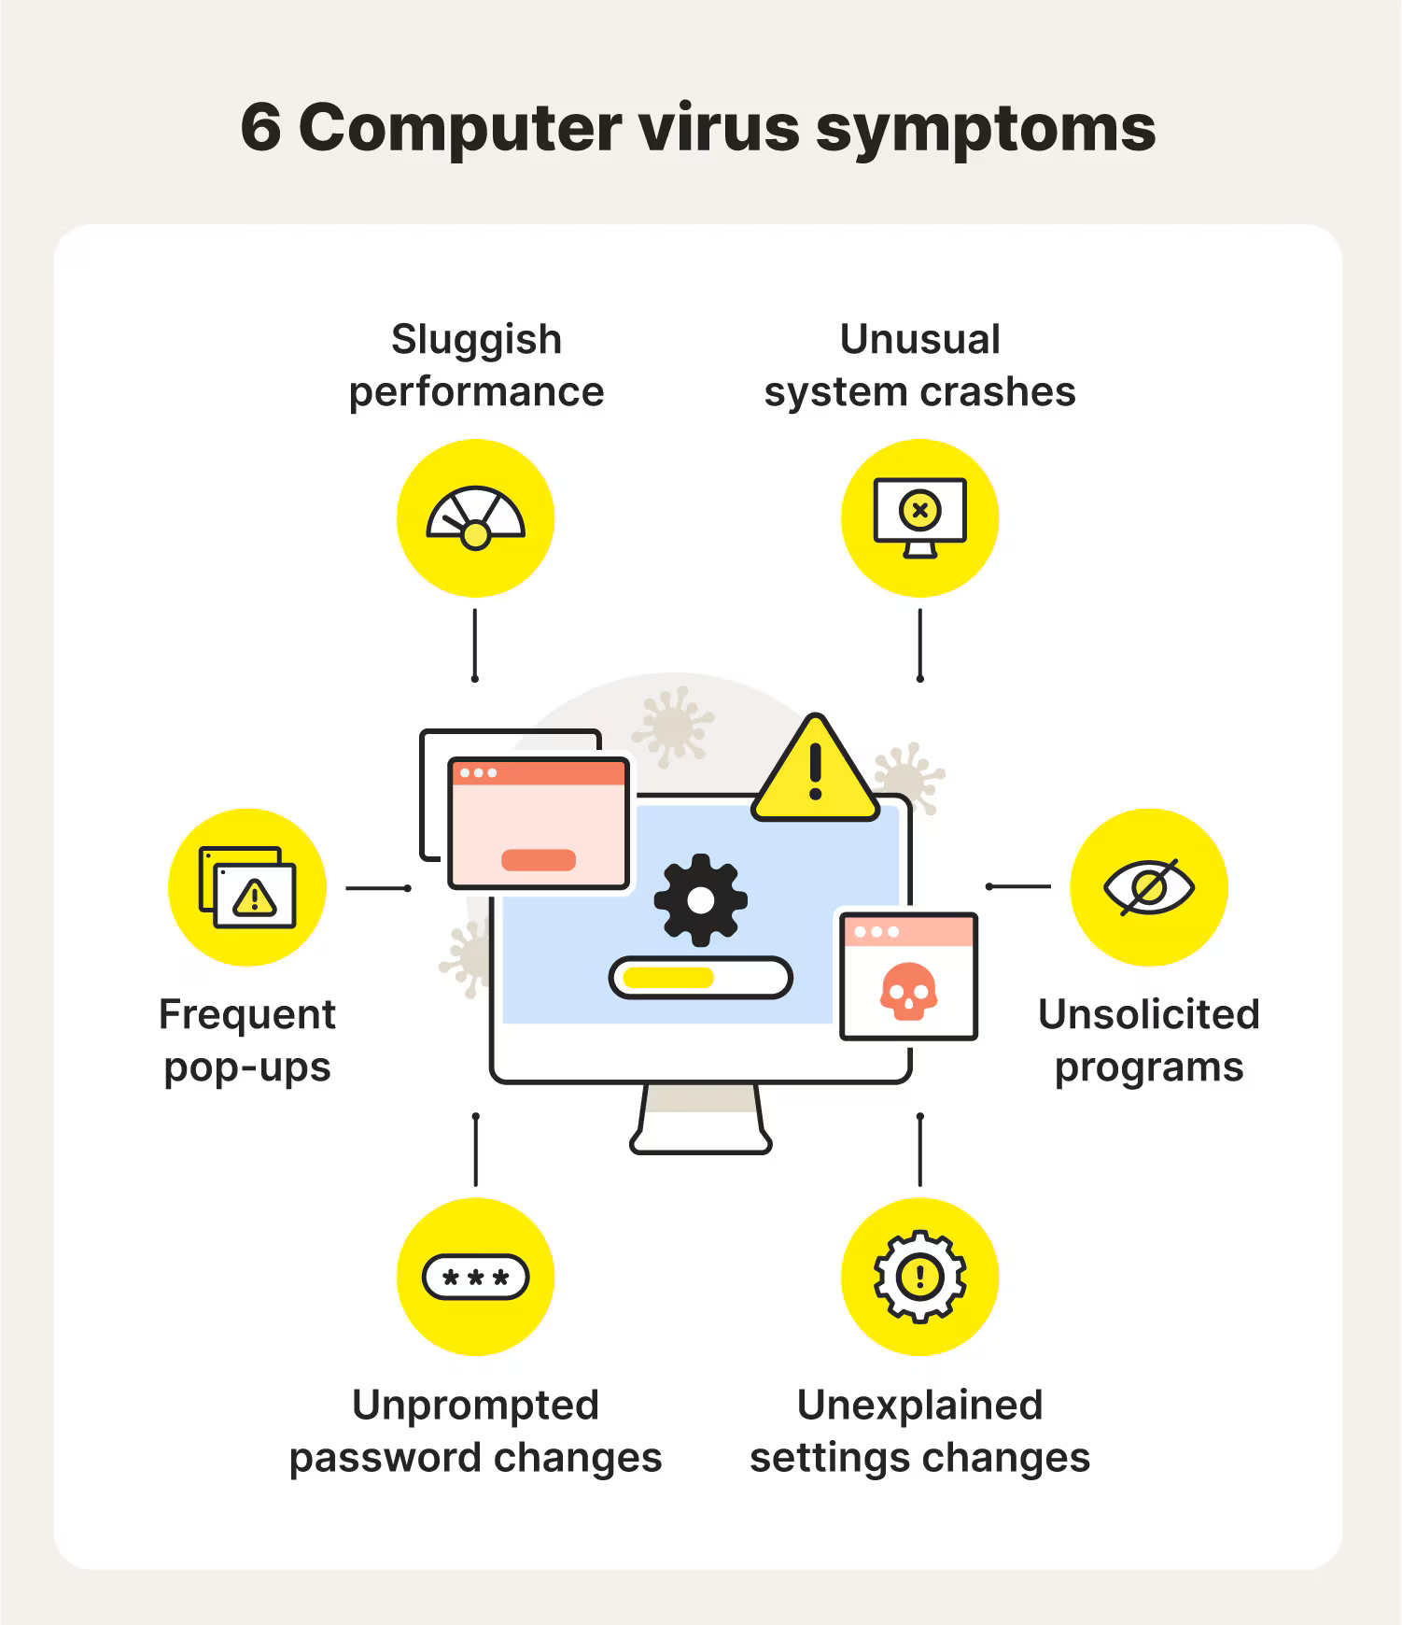
Syllabus Introduction Key Concepts Types of Threats
Best Practices Emerging Trends Conclusion
VIRUS Symptoms

Slide 20

Syllabus Introduction Key Concepts Types of Threats
Best Practices Emerging Trends Conclusion
Viruses
Viruses are malicious software that attach themselves to legitimate programs and files. They spread when the infected software is executed. Here’s how it works:
Infection: The virus attaches to a legitimate file or program. Execution: When the infected file or program is executed, the virus code is also executed.
Spread: The virus replicates and may spread to other files or programs.
Executes
Legitimate Software
User
Attaches to
Replicates
Virus Code
I n f e c t s Executes Virus Code
Infected Software
Spread to Other Files
Figure: Diagram illustrating how a virus attaches to a
legitimate program

Slide 21
Syllabus Introduction Key Concepts Types of Threats
Best Practices Emerging Trends Conclusion
Types of Computer Viruses
Type of Virus | Description | Example
File Infector | Attaches itself to executable files and acti- vates when the file is run. | ILOVEYOU
Macro Virus | Infects documents that contain macros, exe- cuting malicious macros when the document is opened. | Melissa Virus
Polymorphic Virus | Changes its code each time it infects a new file to evade detection. | Storm Worm
Metamorphic Virus | Completely rewrites its own code each time it infects a new file, making detection very difficult. | Simile Virus
Resident Virus | Installs itself in the computer’s memory, al- lowing it to execute malicious code without needing to infect a file. | CIH (Chernobyl)
Non-Resident Virus | Requires a host file to execute, and is active only while the host file is running. | Sasser Virus
Table: Different Types of Computer Viruses

Slide 22
Syllabus Introduction Key Concepts Types of Threats
Best Practices Emerging Trends Conclusion
Signature-Based VIRUS Detection
Description:
Signature-based detection involves identifying viruses by comparing the code of files against a database of known virus signatures (unique patterns of bytes or sequences).
Algorithm:
Maintain a database of virus signatures.
When a file is accessed or executed, compute its hash or extract its byte patterns.
Compare the patterns with those in the signature database.
Flag the file if a match is found.
Pros:
Effective for known viruses.
Low false-positive rate if signatures are accurate.
Cons:
Ineffective against new, unknown viruses.
Requires frequent updates to the signature database.

Slide 23
Syllabus Introduction Key Concepts Types of Threats
Best Practices Emerging Trends Conclusion
Heuristic-Based VIRUS Detection
Description:
Heuristic-based detection involves analyzing the behavior or characteristics of files to identify potential viruses, even if they are not in the signature database.
Algorithm:
Analyze the file’s behavior or code for suspicious characteristics (e.g., self-replication, code injection).
Use predefined rules or heuristics to evaluate the file.
Flag the file if it exhibits behavior that matches known virus patterns or anomalies.
Pros:
Can detect previously unknown viruses. Provides a broader scope for detection.
Cons:
May have a higher false-positive rate. Requires careful tuning of heuristic rules.

Slide 24
Syllabus Introduction Key Concepts Types of Threats
Best Practices Emerging Trends Conclusion
Behavior-Based Detection
Description:
Behavior-based detection monitors the runtime behavior of programs to identify malicious activity.
Algorithm:
Execute the file in a sandbox environment or monitor its actions in real-time. Observe its behavior, such as file modifications, network activity, or system calls.
Flag the file if its behavior matches known malicious patterns or deviations from normal behavior.
Pros:
Can detect new and unknown viruses based on their actions. Provides real-time protection.
Cons:
Requires a dynamic analysis environment (sandbox).
May impact system performance.

Slide 25
Syllabus Introduction Key Concepts Types of Threats
Best Practices Emerging Trends Conclusion
Static Code Analysis
Description:
Static code analysis involves examining the code of a file without executing it, looking for malicious patterns or vulnerabilities.
Algorithm:
Analyze the file’s code or binary without running it.
Search for known malicious code patterns, suspicious function calls, or code anomalies.
Flag the file if malicious patterns or vulnerabilities are detected.
Pros:
Can detect threats before execution.
Useful for analyzing code for known patterns.
Cons:
Limited to what can be detected through code analysis.
May miss threats that are only apparent at runtime.

Slide 26
Syllabus Introduction Key Concepts Types of Threats
Best Practices Emerging Trends Conclusion
Dynamic Analysis
Description:
Dynamic analysis involves executing the file in a controlled environment and observing its behavior to detect malicious activity.
Algorithm:
Run the file in a sandbox or isolated environment.
Monitor its interactions with the system, such as file system changes, network activity, and process creation.
Detect and flag suspicious behavior indicative of a virus.
Pros:
Provides insights into how the file behaves in a real environment. Can detect threats that only manifest during execution.
Cons:
Requires execution of the file, which may be risky.
Resource-intensive and may require sophisticated sandboxing.

Slide 27
Syllabus Introduction Key Concepts Types of Threats
Best Practices Emerging Trends Conclusion
Machine Learning-Based Detection
Description:
Machine learning-based detection involves training models to recognize malicious files based on various features extracted from the files.
Algorithm:
Extract features from files (e.g., byte sequences, system calls, API usage). Train a machine learning model using labeled datasets (malicious vs. benign).
Use the trained model to classify new files as malicious or benign based on their features.
Pros:
Can adapt to new threats by retraining with updated data. Can handle complex patterns and correlations.
Cons:
Requires large labeled datasets for training.
Model performance depends on the quality of training data.

Slide 28
Syllabus Introduction Key Concepts Types of Threats
Best Practices Emerging Trends Conclusion
Anomaly-Based Detection
Description:
Anomaly-based detection involves establishing a baseline of normal behavior and identifying deviations from this baseline as potential threats.
Algorithm:
Monitor the system to establish a baseline of normal behavior. Continuously analyze system activities and compare them to the baseline.
Flag activities that significantly deviate from normal patterns as potential threats.
Pros:
Can detect previously unknown threats.
Flexible and adaptable to changing environments.
Cons:
May have a higher false-positive rate. Requires accurate baseline modeling.
28 / 49

Slide 29
Syllabus Introduction Key Concepts Types of Threats
Best Practices Emerging Trends Conclusion
Sandboxing
Description:
Sandboxing involves executing a file in an isolated environment to observe its behavior without affecting the actual system.
Algorithm:
Create a virtual or isolated environment (sandbox) for file execution.
Monitor and record the file’s behavior, including system changes, network activity, and file access.
Analyze the recorded behavior for signs of malicious activity.
Pros:
Provides a safe environment for testing potentially harmful files. Can detect behavioral indicators of malware.
Cons:
Execution of the file in a sandbox may not always replicate real-world conditions. Performance overhead and resource-intensive.

Slide 30
Syllabus Introduction Key Concepts Types of Threats
Best Practices Emerging Trends Conclusion
Phishing
Phishing is a type of social engineering attack where attackers deceive individuals into providing sensitive information such as usernames, passwords, or credit card numbers. Phishing typically occurs via:
Email: Fake emails that appear to be from legitimate sources requesting personal information.
Websites: Fraudulent websites are designed to look like legitimate sites to steal
user credentials.
Messages: Text messages or social media messages that trick individuals into revealing personal information.

Slide 31
Syllabus Introduction Key Concepts Types of Threats
Best Practices Emerging Trends Conclusion
Types of Phishing and Their Properties
Type of Phishing | Description | Common Indicators
Email Phishing | Uses fraudulent emails that appear to come from a legitimate source to trick users into revealing sensitive information. | Suspicious sender address, urgent language, unexpected attachments or links.
Spear Phishing | Targets specific individuals or organizations with personalized emails to increase the like- lihood of success. | Personalization of email content, often con- tains specific details about the target.
Whaling | A type of spear phishing targeting high- profile individuals such as executives or im- portant figures within an organization. | High level of personalization, often involves high-value targets or sensitive topics.
Smishing | Phishing conducted via SMS or text mes- sages. Often includes a link to a fake website or requests personal information directly. | Unexpected text messages, urgent requests for personal information, suspicious links.
Vishing | Voice phishing carried out over phone calls, where attackers impersonate legitimate or- ganizations to extract sensitive information. | Unsolicited calls, requests for personal infor- mation, pressure to act quickly.
Clone Phishing | Involves creating a nearly identical replica of a legitimate email that has been previ- ously sent, but with malicious links or at- tachments. | Identical design to a legitimate email, but with altered or new malicious content.
Table: Different Types of Phishing and Their Properties

Slide 32
Syllabus Introduction Key Concepts Types of Threats
Best Practices Emerging Trends Conclusion
Email Phishing Diagram
Attacker
Crafts Phishing Email Sends Email to Victim
Victim Receives Email Clicks Malicious Link
Fake Website Attacker Collects Data
Description
Email Phishing:
Uses fraudulent emails that appear to come from a legitimate source to trick users into revealing sensitive information.
Common Indicators:
Suspicious sender address Urgent language

Slide 33
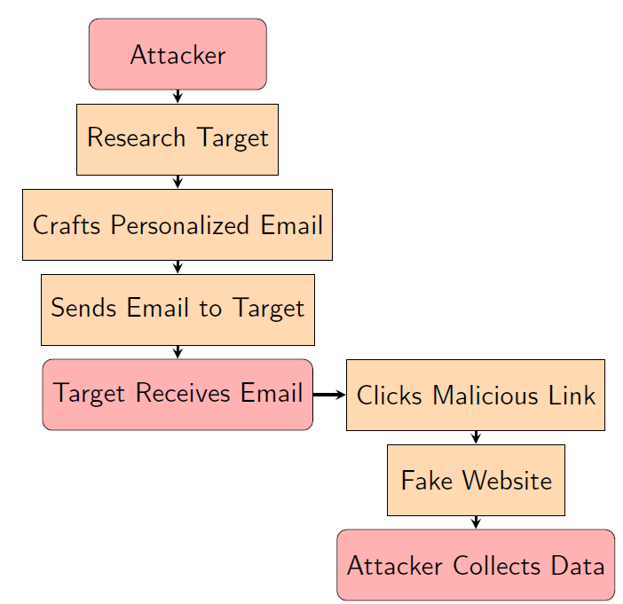
Syllabus Introduction Key Concepts Types of Threats
Best Practices Emerging Trends Conclusion
Spear Phishing Diagram
Description
Spear Phishing:
Targets specific individuals or organizations with personalized messages to increase the likelihood of success.
Typical Steps:
Research Target: The attacker gathers information about the target to make the phishing attempt more convincing.
Crafts Personalized Email: The attacker
creates an email that appears to come from a trusted source, using information gathered about the target.
Sends Email to Target: The attacker sends
the personalized email to the target.
Clicks Malicious Link: The target clicks on a link within the email that directs to a fraudulent website.
Fake Website: The website collects
sensitive information from the target. Attacker Collects Data: The attacker gathers the information entered by the target on the fake website.
Figure: Diagram illustrating a phishing attack.

Slide 34
Syllabus Introduction Key Concepts Types of Threats
Best Practices Emerging Trends Conclusion
Denial of Service (DoS) Attacks
A Denial of Service (DoS) attack aims to make a network service, server, or website unavailable to users by overwhelming it with a flood of illegitimate requests. Variants include:
SYN Flood: Exploits the TCP handshake process to overload servers.
UDP Flood: Sends a large number of UDP packets to random ports, causing a system to exhaust resources.
HTTP Flood: Targets web servers by sending a large volume of HTTP requests.

Slide 35
Syllabus
Introduction Key Concepts Types of Threats
Best Practices Emerging Trends Conclusion
DoS
Attacker
DoS
Flood
NetworkServer
Initiates Attack
Sends Flood of Requests
Overwhelms Network/Server
No Response (Outage)
Figure: Diagram illustrating a phishing attack.
Denial of Service (DoS) Attack:
Aims to make a service, network, or system unavailable by overwhelming it with a flood of illegitimate requests.
Typical Methods:
Flood Attack: Sends a massive volume of traffic to exhaust the system’s resources, causing service disruption.
Ping of Death: Sends oversized or malformed packets to crash or freeze the target system.
SYN Flood: Exploits the TCP handshake process by sending numerous connection requests without completing them, exhausting server resources.
Distributed Denial of Service (DDoS): Utilizes multiple compromised systems to generate
a coordinated flood of traffic, amplifying the attack’s impact
.

Slide 36
Syllabus Introduction Key Concepts Types of Threats
Best Practices Emerging Trends Conclusion
DoS Attack Types
Volume-Based Attacks Protocol Attacks Application Layer Attacks
Distributed Denial of Service (DDoS) Attacks Resource Exhaustion Attacks
Amplification Attacks Zero-Day Attacks

Slide 37
Syllabus Introduction Key Concepts Types of Threats
Best Practices Emerging Trends Conclusion
Volume-Based Attacks
UDP Flood: Sends a large number of UDP packets to random ports, consuming resources.
ICMP Flood: Sends a flood of ICMP Echo Request packets to overwhelm the target.
ICMP (Internet Control Message Protocol) packets are crucial for network operations and diagnostics.
Major Operations: Error Reporting, Network Diagnostics, Flow Control, and Network Management.

Slide 38
Syllabus Introduction Key Concepts Types of Threats
Best Practices Emerging Trends Conclusion
Protocol Attacks
SYN Flood: Exploits TCP handshake by sending SYN requests without completing the handshake.
Ping of Death: Sends maliciously crafted ping packets that overflow memory buffers.

Slide 39
Syllabus Introduction Key Concepts Types of Threats
Best Practices Emerging Trends Conclusion
Application Layer Attacks
HTTP Flood: Sends a large number of HTTP requests to exhaust server resources.
Slowloris: Holds connections open with partial HTTP headers, consuming server resources.

Slide 40
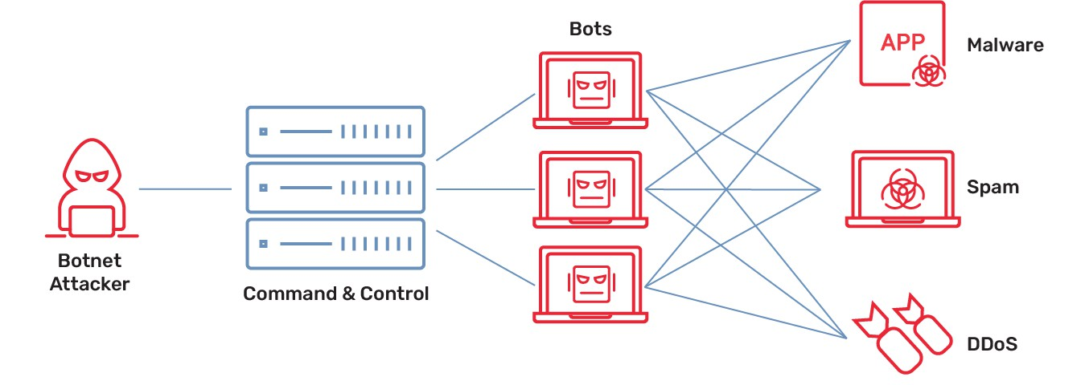
Distributed Denial of Service (DDoS) Attacks
Syllabus Introduction Key Concepts Types of Threats Best Practices Emerging Trends Conclusion
Botnet-Based Attacks: Uses a network of compromised devices to launch coordinated attacks.
Figure: Diagram illustrating Botnet-based attacks

Slide 41
Syllabus Introduction Key Concepts Types of Threats
Best Practices Emerging Trends Conclusion
Resource Exhaustion Attacks
Memory Flood: Overloads the target’s memory with excessive data.
CPU Flood: Consumes CPU resources with complex or computationally intensive requests.

Slide 42
Syllabus Introduction Key Concepts Types of Threats
Best Practices Emerging Trends Conclusion
Amplification Attacks
DNS Amplification: Uses open DNS resolvers to flood the target with large responses.
NTP Amplification: Uses NTP servers to generate high volumes of traffic.

Slide 43
Syllabus Introduction Key Concepts Types of Threats
Best Practices Emerging Trends Conclusion
Zero-Day Attacks
Exploit Unknown Vulnerabilities: Uses unknown or unpatched vulnerabilities to launch attacks.

Slide 44
Syllabus Introduction Key Concepts Types of Threats
Best Practices Emerging Trends Conclusion
Man-in-the-Middle (MitM) Attacks
In a Man-in-the-Middle attack, an attacker intercepts and potentially alters communication between two parties without their knowledge. Common techniques include:
Eavesdropping: Intercepting communications to gain information.
Session Hijacking: Taking over a web session to impersonate the user.
SSL Stripping: Downgrading a secure HTTPS connection to an unencrypted HTTP connection to intercept data.

Slide 45
Syllabus Introduction Key Concepts Types of Threats
Best Practices Emerging Trends Conclusion
Insider Threats
Insider threats involve malicious or negligent actions by individuals within an organization that compromise security. These threats can come from:
Disgruntled Employees: Individuals who intentionally cause harm to the organization.
Negligent Employees: Individuals who unintentionally expose the organization to risks through careless actions.
Compromised Accounts: Employee accounts that have been hacked and used to access sensitive information.

Slide 46
Syllabus Introduction Key Concepts Types of Threats
Best Practices Emerging Trends Conclusion
Best Practices
Use Strong Passwords Regular Software Updates
Firewalls and Antivirus Software Data Encryption
Security Awareness Training

Slide 47
Syllabus Introduction Key Concepts Types of Threats
Best Practices Emerging Trends Conclusion
Emerging Trends
AI and Machine Learning in Security Zero Trust Architecture
Cloud Security
Privacy Regulations (e.g., GDPR, CCPA)

Slide 48
Syllabus Introduction Key Concepts Types of Threats
Best Practices Emerging Trends Conclusion
Conclusion
Summary of Key Points Importance of Staying Informed Future Directions in Cybersecurity

Slide 49
Syllabus Introduction Key Concepts Types of Threats
Best Practices Emerging Trends Conclusion
Questions
Any Questions?

